Slide 1
WELCOME

Slide 2
VEHICLE INSURANCE By SAHAL

Slide 3
INTRODUCTION
A CONTRACT BY WHICH THE INSURER ASSUMES THE RISK OF ANY LOSS THE OWNER OR OPERATOR OF A CAR MAY INCUR THROUGH DAMAGE TO PROPERTY OR PERSONS AS THE RESULT OF AN ACCIDENT

Slide 4
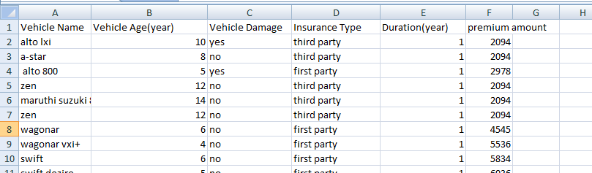
DATA SET
:- Insurance Prediction

Slide 5
Dependent(y)& Independent Variable(x)
X:-
* Vehicle Name
* Vehicle Age(year)
* Vehicle Damage
* Insurance Type
* Duration(year)
Y:-
* premium amount

Slide 6
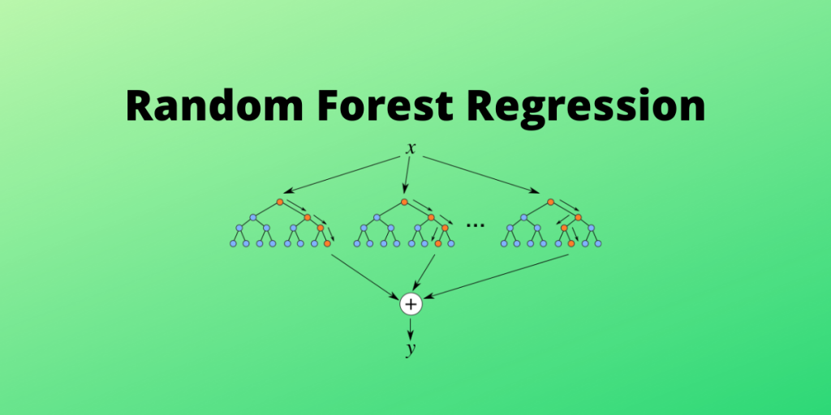
Algoritham used:- Random Forest Regressor score-86
It is a Supervised learning algoritham that uses ensemble learning method for regression

Slide 7
Preprocessing step *label encoder *minmax scaler

Slide 8
FRONT-END *HTML(HyperTextMarkup Language) *css(Cascading Style Sheets)

Slide 9
BACK-END *python

Slide 10
CONCLUSION The type of covers each car insurance companies provide will vary

Slide 11
THANKS

